Slide 1
Cryptocurrency Portfolio Optimization
Kurs 5 - Quantitative Optimization Methods in Finance

Slide 2
Group Members
Thomas Dornigg, 1551056
Philipp Panzenböck,

Slide 3
Content
Introduction
Basic principles of the Modern Portfolio Theory (MPT)
Overview of the cryptocurrency-data
Coin-prices extraction (price differences of crypto-exchanges)
Testing for normality distribution of returns
Histogramms
QQ-Plots
Boxplots
Correlation Analysis (Heatmaps)
Portfolio Optimization
Conclusion

Slide 4
Introduction
Cryptoassets are a new and emerging type of alternative investment, thus it is appropriate for innovative and forward-looking investors to evaluate their advantages and to assess their expected return, volatility, and correlation with other assets
As a result, the main purpose of this work is to apply the mathematical framework of Modern Portfolio Theory to this unconventional asset class and later on, compare it with a traditional stock-portfolio and mixed portfolio
By doing so, we want to investigate whether investing in cryptoassets may be attractive for investors
In applying the Markowitz’s Portfolio Theory, we intend to take advantage of joint variability of assets to reduce the overall volatility of a portfolio

Slide 5
2. Basic Principles of Modern Portfolio Theory (MPT)
Pioneered by economist Harry Markowitz (1952), for which he was later awarded the Nobel Prize
MPT or mean-variance analysis is a mathematical framework on how risk-averse investors can construct portfolios to optimize or maximize expected return based on a given level of market risk, emphasizing that risk is an inherent part of higher reward
According to the theory, it's possible to construct an "efficient frontier" of optimal portfolios offering the maximum possible expected return for a given level of risk
One of the core statements of the theory is, that investors can reduce portfolio variance through diversification, by holding assets which are not perfectly positively correlated

Slide 6
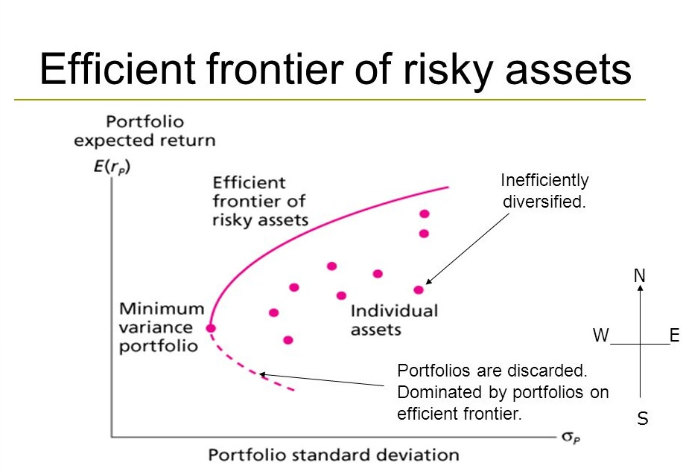

Slide 7
2.1 MPT - Basic Assumptions
Asset returns are normally distributed random variables
Investors are regarded as rational and risk-averse
Investors all have access to the same sources of information for investment decisions, i.e no information-asymmetry
Investors share similar views on expected returns
No consideration of taxes or fees of any kind
The user of the model is a price taker, not a price maker (i.e. the investor is unable to influence the exercise price of his/her investment by any invested amount of money)
Investors have unlimited access to borrow (and lend) money at the risk free rate
Assumption that an investor is not allowed to set up short positions in a security. Only long positions are allowed.
By market risk, we consider both positive and negative deviations of the actual return from the expected one

Slide 8
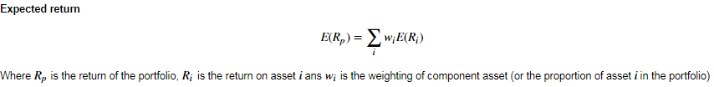
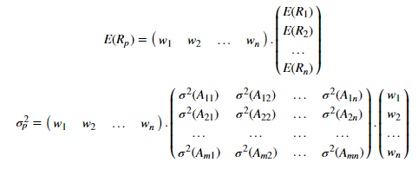
2.2 MPT - Basic mathematical framework

Slide 9
3. Overview of the cryptocurrency-data
Portfolio consisting of 20 cryptocurrencies
Time range from 2016-01-01 till 2018-12-07
Coin prices for main dataframe were extracted via API from CryptoCompare
Following Coins are part of the portfolio:
Bitcoin (BTC)
Ripple (XRP)
Ethereum (ETH)
Litecoin (LTC)
Monero (XMR
BitBar (BTB)
Decred (DCR)
Nxt (NXT)
Factom (FCT)
Dash (DASH)
MaidSafeCoin (MAID)
Bytecoin (BCN)
BitShares (BTS)
Siacoin (SC)
DigiByte (DGB)
MaidSafeCoin (MAID)
Bytecoin (BCN)
BitShares (BTS)
Siacoin (SC)
DigiByte (DGB)

Slide 10
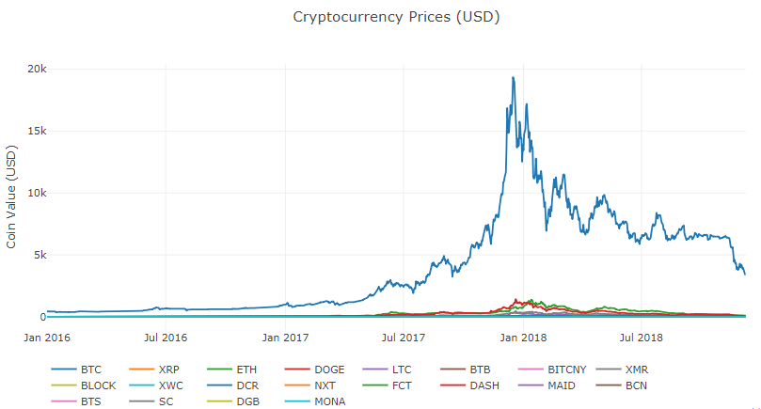

Slide 11
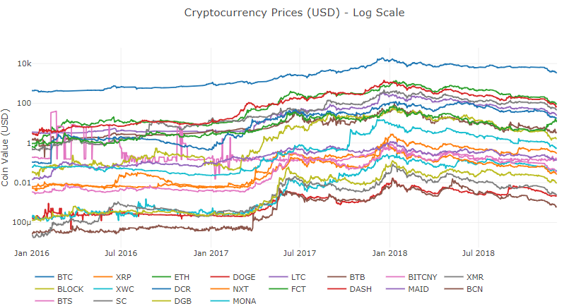

Slide 12
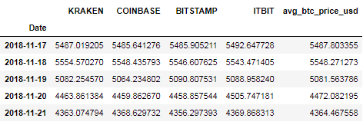
3.a Price differences between exchanges
Coin prices vary between exchanges
For instance, as of 10:50 a.m. on Tuesday (12 Dec 2017), Bitcoin was trading on these exchanges at the following price points:
Kraken - $17,212
GDAX - $17,150
Gemini - $17,039
Bitfinex - $16957
Bitstamp - $16,979
What are the reasons for that?
supply and demand (liquidity)
nobody knows what it's "supposed" to cost/the real price
infrastructure issue (difficult to make use of arbitrage opportunities)

Slide 13
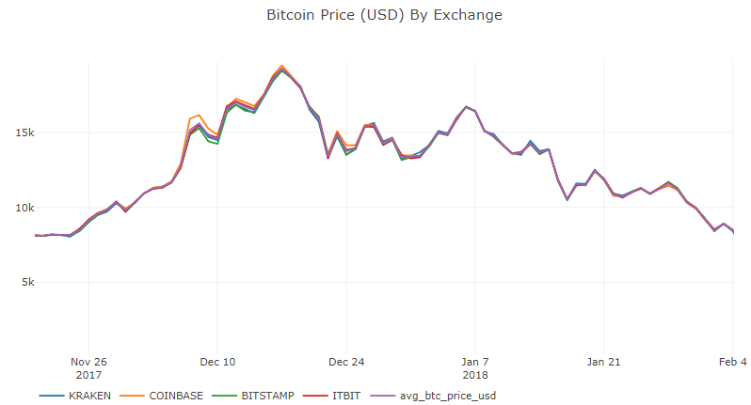

Slide 14
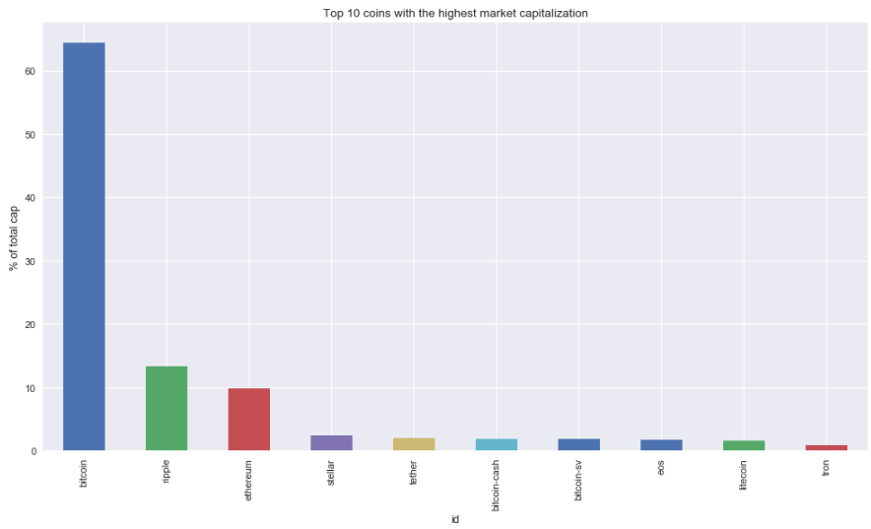
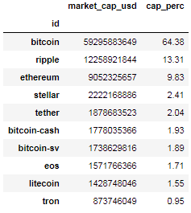

Slide 15
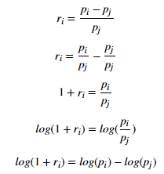
3.b Testing for normality distribution of returns
Large number of important financial models, like the mean-variance portfolio theory and the capital asset pricing model (CAPM), rest on the assumption that returns of securities are normally distributed
Python provides efficient statistical and graphical tools for testing time series data for normality
Transformation of price data to returns:

Slide 16
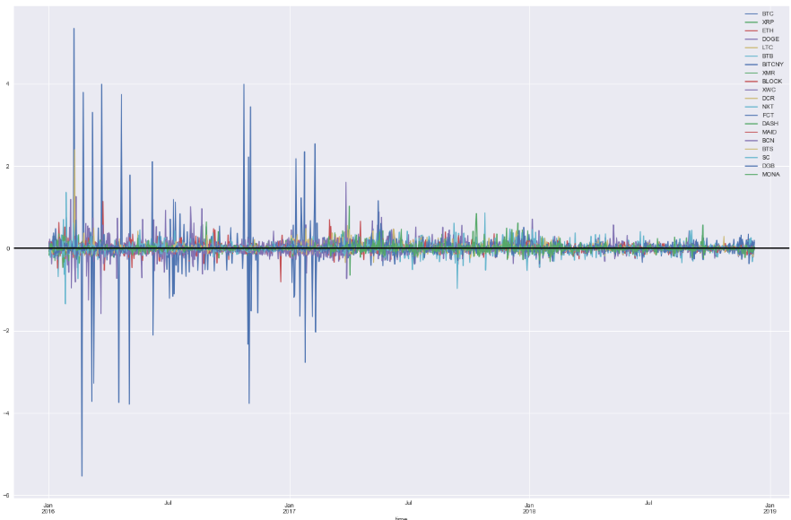

Slide 17
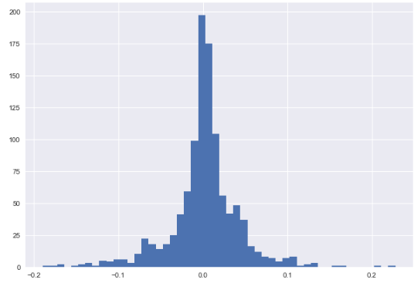
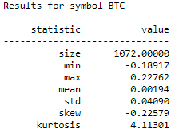
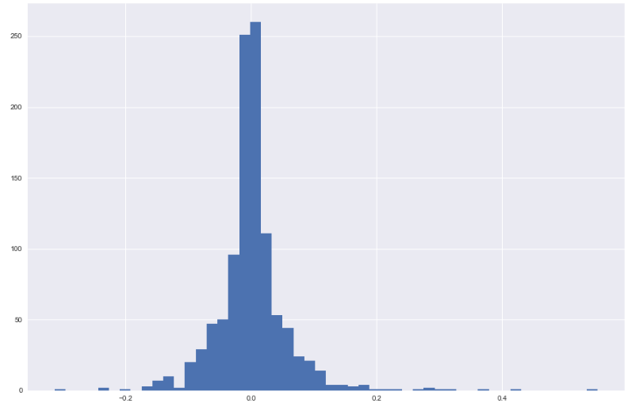
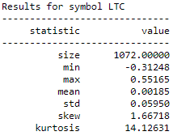
Bitcoin (BTC)
Litecoin (LTC)

Slide 18
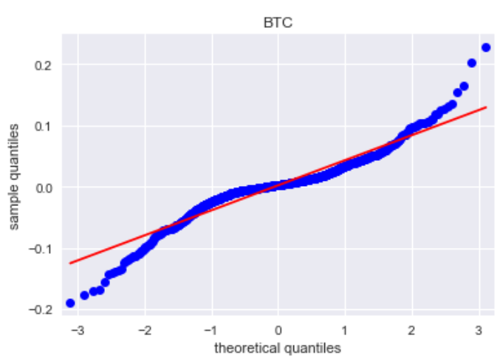
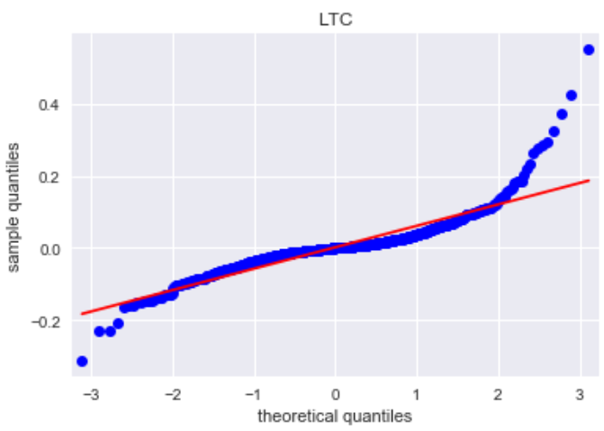

Slide 19
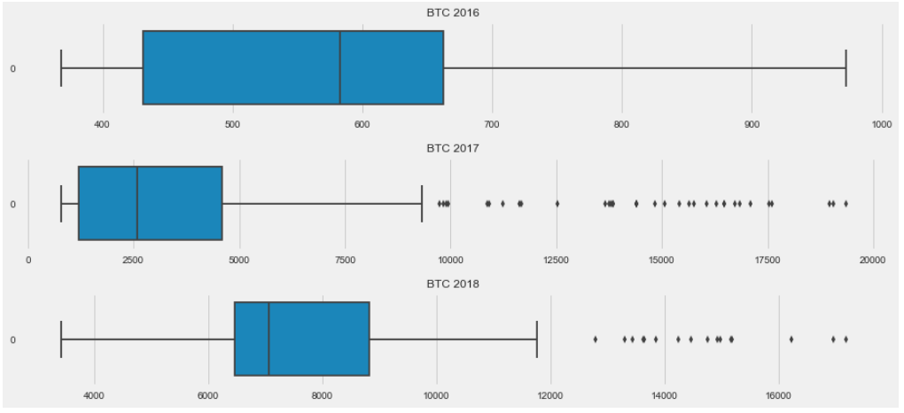

Slide 20
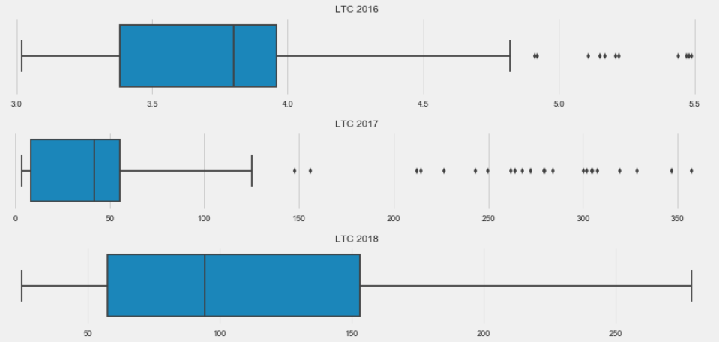

Slide 21


3.c Correlation Analysis
Correlation analysis is a method of statistical evaluation used to study the strength of a relationship between two, numerically measured, continuous variables
This particular type of analysis is useful when to figure out if there are possible connections between assets
If correlation is found between two variables, it means that when there is a systematic change in one variable, there is also a systematic change in the other; the variables alter together over a certain period of time
If there is correlation found, depending upon the numerical values measured, this can be either positive or negative

Slide 22
Why use Correlation Coefficients?
Identify similar price behaviour of coins/stocks in the past
Risk management: Diversify by choosing uncorrelated coins/stocks. Hence, a diversified portfolio would have various correlation coefficients, i.e including coins with a negative correlation coefficient into the portfolio can reduce the variance and therefore the risk
Allow a useful reallocation of portfolio assets over time

Slide 23
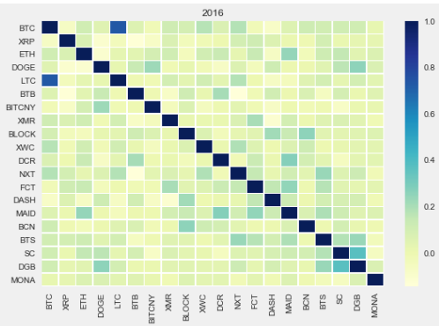
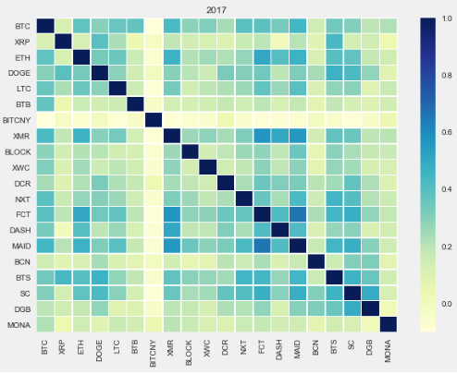
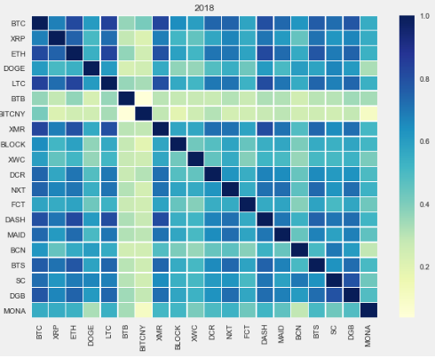

Slide 24
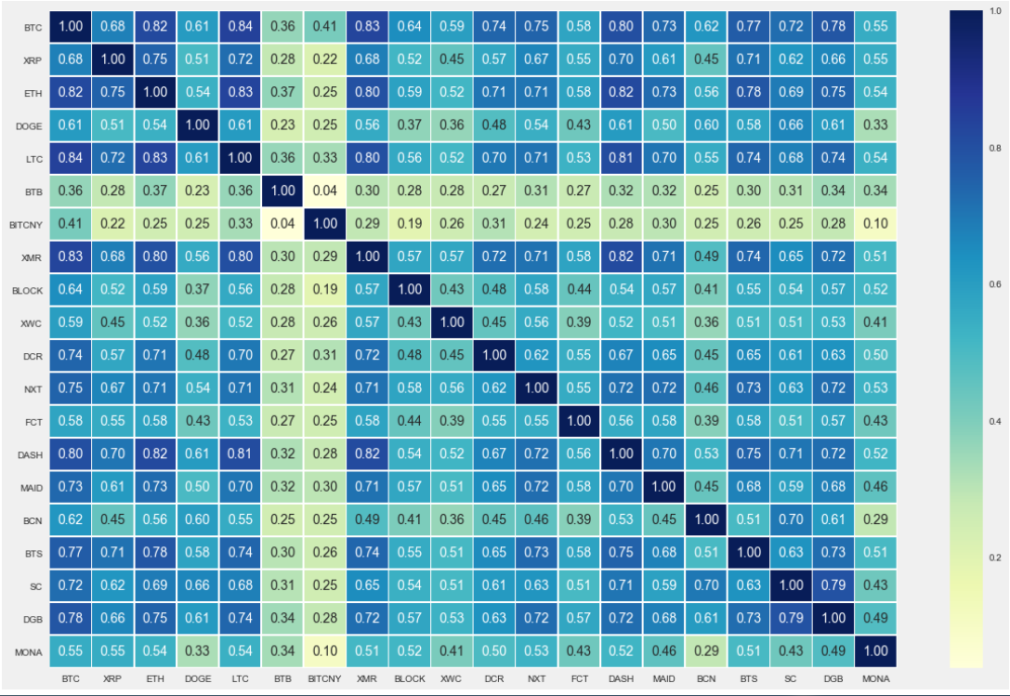

Slide 25
4. Portfolio Optimization
Introduction
First, explanation of methods used for optimizing various portfolios:
Monte Carlo Simulation
Mathematical Optimization
Furthermore, we will compare the result of the crypto-portfolio optimization with optimizations performed on a mixed-portfolio (cryptocurrencies and stocks) and a portfolio based on selected stocks of the S&P 500

Slide 26

4. 1 The Basic Theory
For a given set of securities, we must determine if various risk-return profiles exist. Our tool to this end is Monte Carlo Simulation. Monte Carlo Simulation is method of repeated random sampling from a probability distribution to obtain numerical results
With Monte Carlo simulation we will generate random portfolio weighting allocations and record the expected return and variance. The following code (next slide) generates 20 random numbers between 0 and 1 and then normalizes the values such that the sum of all values equals 1
We calculate an expected portfolio return and expected portfolio standard deviation for each profile. The resulting ratio of returns to standard deviations is referred to as the Sharpe Ratio
The Sharpe Ratio is technically defined as the expected excess return of the portfolio over the risk-free short rate divided by the expected standard deviation of the portfolio. For simplicity, we assume r_{f} = 0

Slide 27
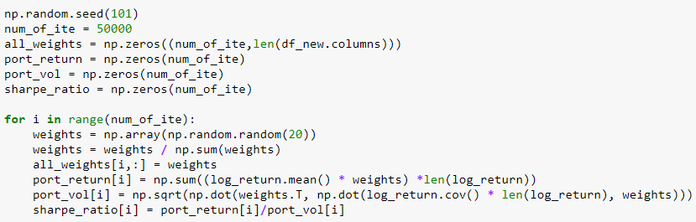
Monte Carlo Simulation for Asset Allocation

Slide 28
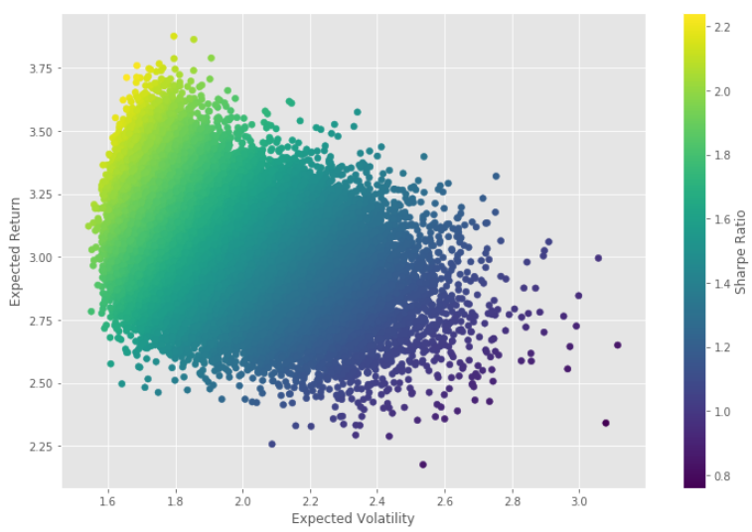

Slide 29
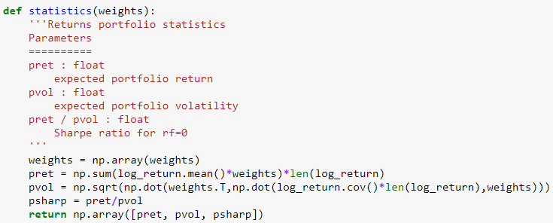
4.2 Mathematical Optimization
Optimization tool for this analysis is the optimize method from the library SciPy
Let's define our objective function as a function which takes an array of weights as an input and returns the Expected Return, Expected Volatility and Sharpe Ratio.
We will also pass a few constraints to the optimization which limits the sum of the weights to 1

Slide 30
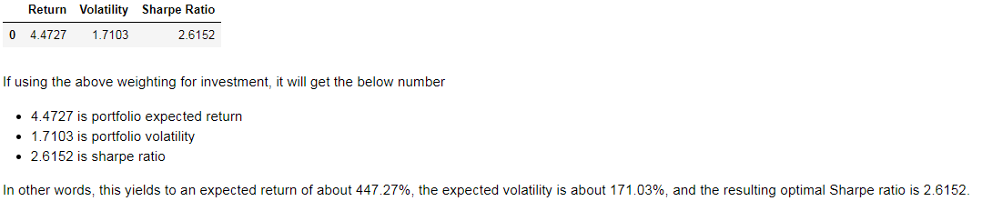

Slide 31
4.3.1 Optimization comparison - portfolio composition
Mixed portfolio:
10 crypto-assets
10 blue chip stocks of the S&P 500 (highest market cap)
Stock portfolio:
10 blue chip stocks of the S&P 500 (highest market cap)
10 random selected stocks (selection process with web-scraping)

Slide 32
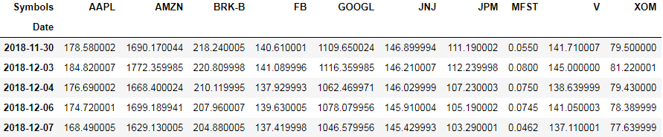
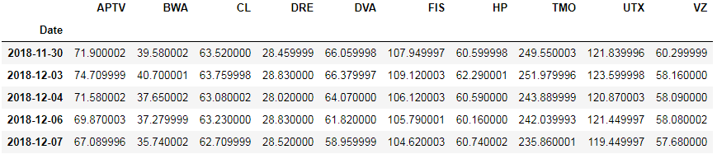

Slide 33
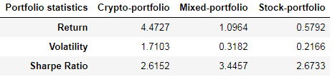
4.3.2 Optimization comparisons - results

Slide 34
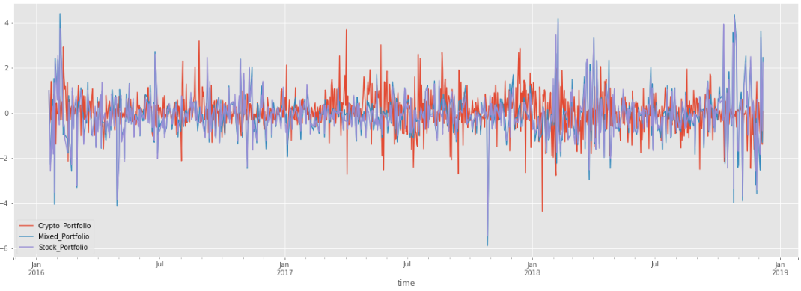
4.4 Indices Creation

Slide 35
